Slide 1
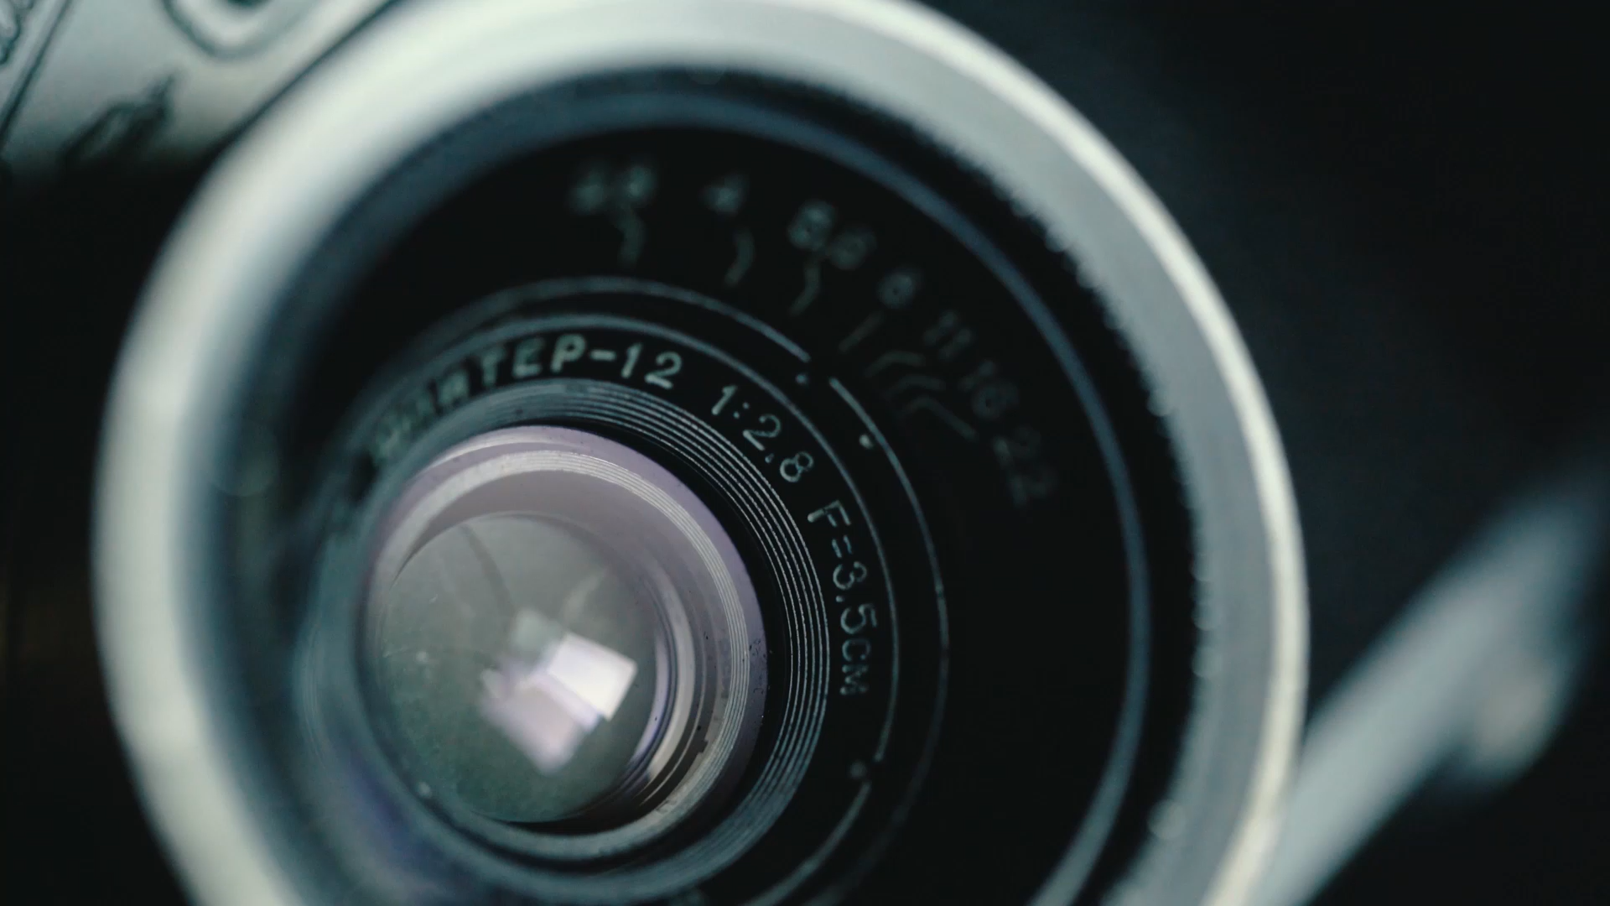
Depth Pro – Zero-Shot Metric Monocular Depth Estimation
Presented by
Ashwin Pawar
Bharath Bandlamudi
Puneeth Chowdary Anantha

Slide 2

Abstract
Depth Pro is a foundation model for zero-shot metric monocular depth estimation. It predicts high-resolution, sharp depth maps with absolute scale from a single image—no camera intrinsics needed. Running in 0.3 seconds on a 2.25 MP image, it combines a multi-scale vision transformer, real+synthetic training, edge-aware loss functions, and a novel boundary accuracy metric. It also estimates focal length and is open-sourced for the community.

Slide 3
Introduction
Monocular depth estimation is essential for view synthesis, image editing, and AR. Depth Pro aims to:
• First, the depth estimator work zero-shot on any image, not restricted to a specific domain
• Low latency is essential - depth maps must be generated in under one second to enable real-time interactive viewing experiences.

Slide 4
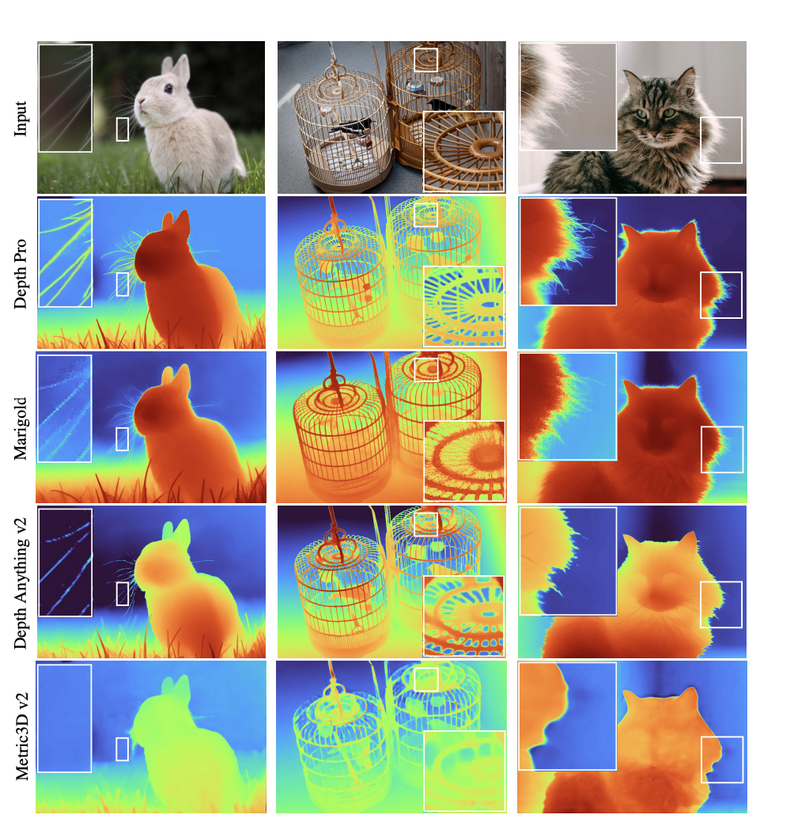
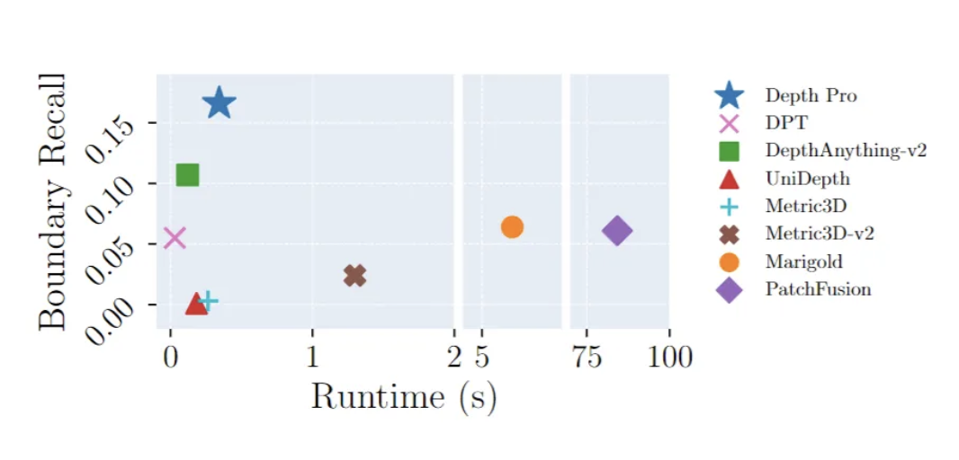
Boundary recall versus runtime. Depth Pro outperforms prior work by a multiplicative factor in boundary accuracy while being orders of magnitude faster than works focusing on fine-grained predictions

Slide 5
Related Work: Zero-shot Depth
Zero-Shot models: Evolution and Advances
Previous Approaches
Early success: MiDaS and MegaDepth demonstrated cross-dataset generalization
Metric3D, LeReS, and ZeroDepth required camera intrinsics or additional metadata
Some methods estimated scale using extra networks or point clouds
Competing diffusion-based methods lack scalability and suffer from slow inference
Depth Pro: Next-Generation Solution
Builds on previous work with Vision Transformers (ViTs)
Uses real + synthetic data mix with edge-aware training for sharp results
Directly predicts metric depth from images without camera metadata
Estimates focal length from image features alone
Fast, scalable, and truly zero-shot across diverse environments

Slide 6
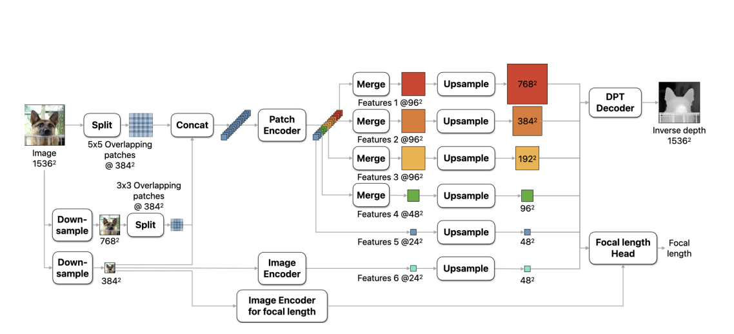
Methods: Network Overview
Depth Pro architecture primarily involves four main components:
Image Encoder
Patch Encoder
DPT Decoder
Focal length Head

Slide 7
Methods: Network Overview
Input image is downsampled into 384, 768, and 1536 scales.
Overlapping 384×384 patches are extracted.
Each patch is passed through a shared ViT Patch Encoder.
Global Image Encoder gives scene-wide context.
DPT Decoder fuses all features into a sharp 1536² depth map.
Focal Length Head predicts field of view from image.

Slide 8

Sharp Monocular Depth Estimation – Loss Functions & Training
Goal: Train Depth Pro to predict sharp, accurate depth maps with real-world metric scale and clear object edges.
Challenges:
Most depth models blur object boundaries.
Real-world depth datasets have errors & missing values.
Training requires a mix of real and synthetic data.

Slide 9
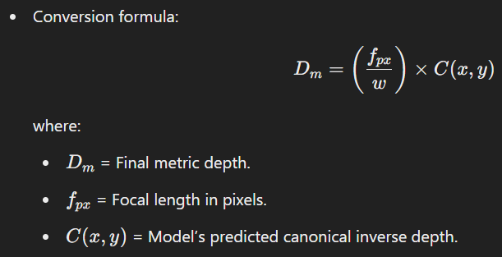
Canonical Inverse Depth (What the Model Predicts)
Depth Pro does not predict absolute depth directly.
It predicts "canonical inverse depth":
Defined as: 1 / Depth (gives more importance to nearby objects).
Scaled later using focal length to get metric depth.

Slide 10
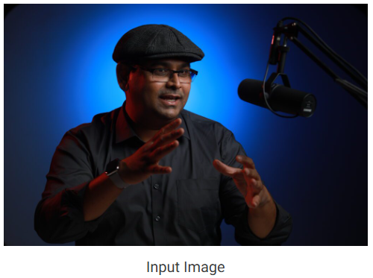
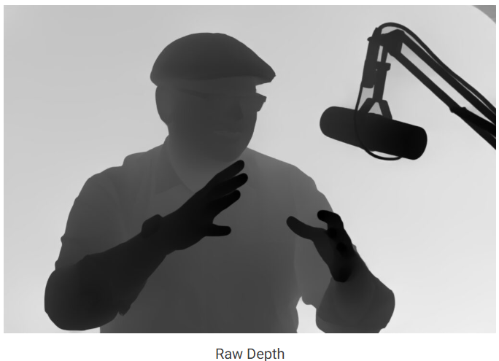
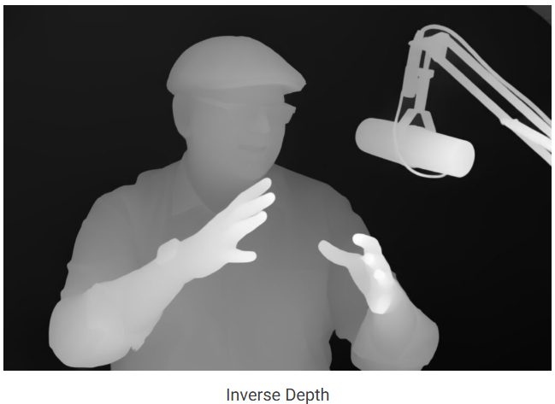
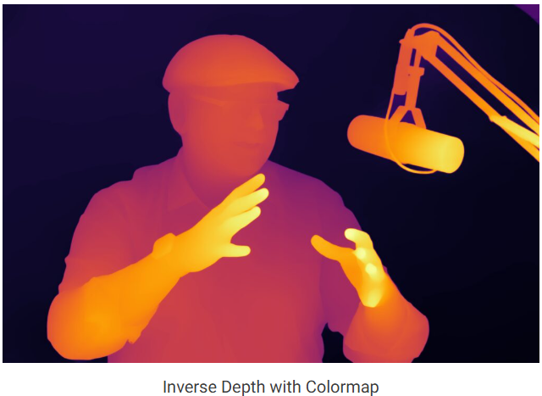

Slide 11
Loss Functions – Ensuring Accurate Depth
Multiple loss functions ensure both depth accuracy and edge sharpness:
L1 loss on inverse depth (for metric datasets)
Removes top 20% highest-error pixels (to avoid noisy depth points).
Scale-invariant loss (for relative-depth datasets)
Aligns depth maps without absolute scale.
Gradient losses (sharp edges!)
Mean Absolute Gradient Error (MAGE): Forces sharp changes in depth at edges.
Mean Absolute Laplacian Error (MALE): Preserves thin objects & fine details.
Mean Squared Gradient Error (MSGE): Helps prevent over-smoothing.

Slide 12
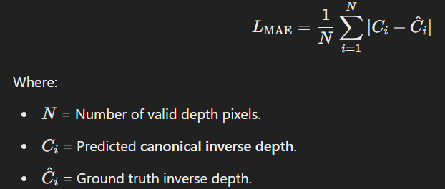
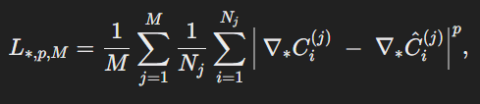
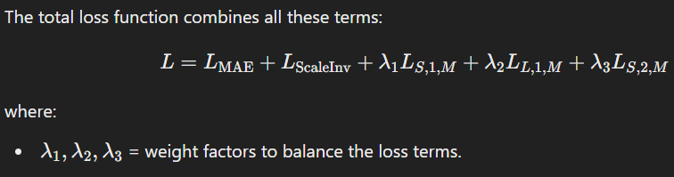
Loss Functions – Ensuring Accurate Depth
L1 loss on inverse depth (for metric datasets)
Scale-invariant loss (for relative-depth datasets)
Gradient losses (sharp edges!)

Slide 13
Two-Stage Training Curriculum
Stage 1: General Depth Learning
Training on both real and synthetic datasets.
Focuses on coarse depth structure using:
L1 depth loss for metric data.
Scale-invariant loss for non-metric data.
Gradient loss only on synthetic data (real data has noisy edges).
Stage 2: Fine-Tuning for Sharp Edges
Training only on synthetic datasets (where depth edges are perfect).
Activates full gradient losses:
Forces model to sharpen boundaries without real-world noise.
Result: Crisp depth edges & sharp occlusions.

Slide 14
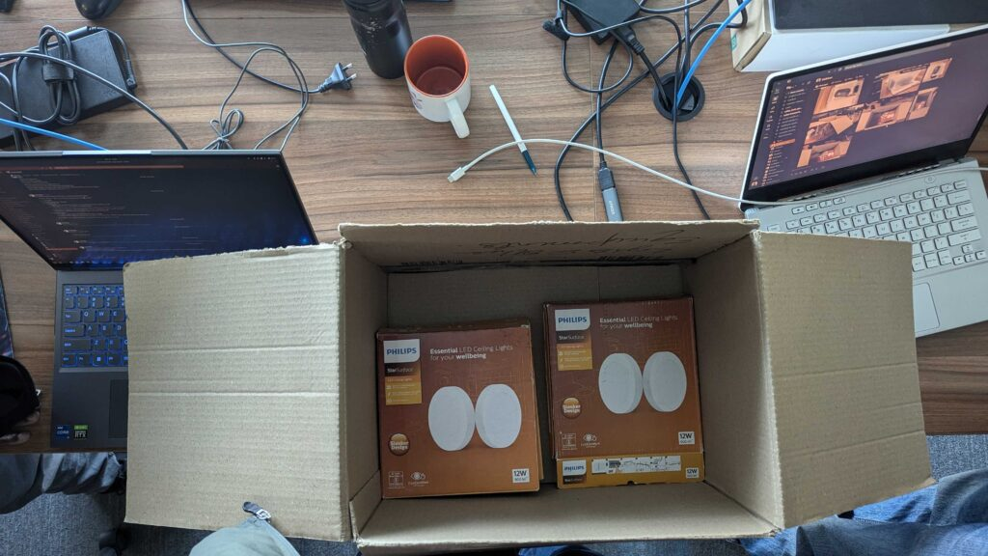
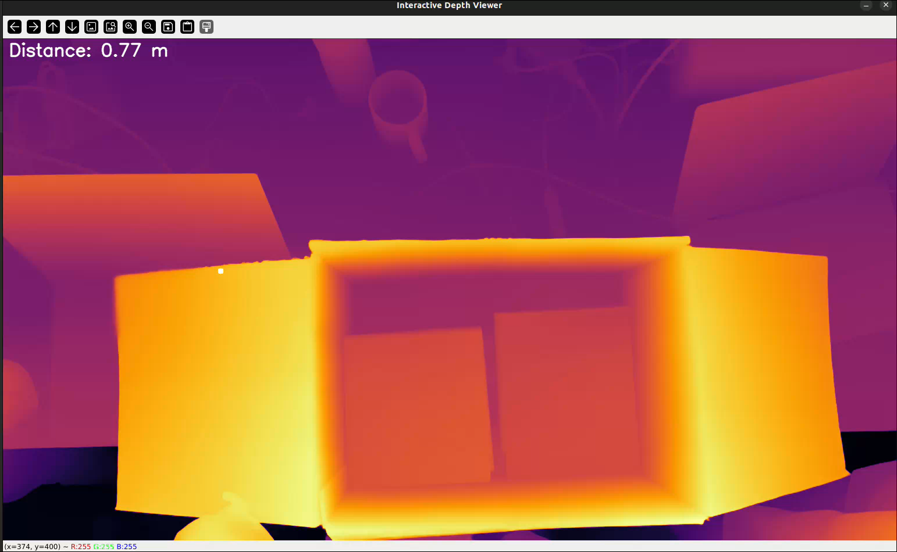

Slide 15
Data Used – Real & Synthetic
Real-world depth datasets:
NYU Depth V2, KITTI, DDAD, ScanNet, etc.
Often have noisy edges due to sensor limitations.
Synthetic datasets:
Hypersim, Virtual KITTI, UnrealStereo, etc.
Perfect ground truth depth, useful for sharpening training.

Slide 16
Experiments and Results – Overview
Depth Pro evaluated across multiple datasets in zero-shot settings.
Outperforms or matches state-of-the-art in both depth accuracy and sharp boundaries.
Also evaluated for focal length estimation and runtime efficiency.

Slide 17
Zero-Shot Metric Depth Accuracy
δ₁: % of pixels where predicted depth is within 25% of ground truth.
Datasets: Booster, Middlebury, SUN RGB-D, ETH3D, nuScenes, Sintel.
Depth Pro achieves the best average rank (2.5) across datasets.

Slide 18
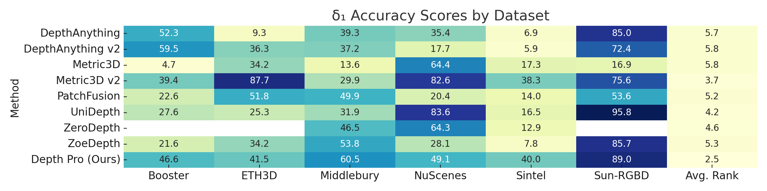
Table: Metric Depth Accuracy

Slide 19
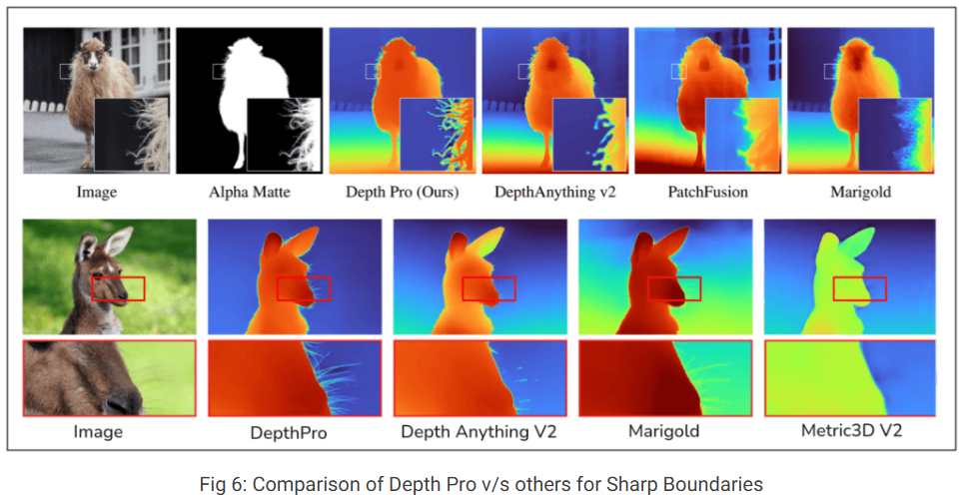
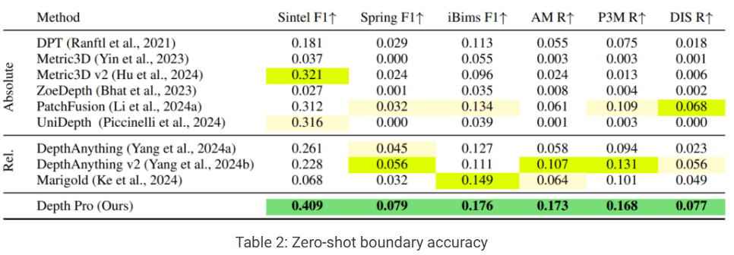
Zero-Shot Boundary Accuracy
Datasets: Sintel, Spring, iBims-1, AM-2k, P3M, DIS.
Metrics: F1 score and Recall for edge alignment.
Depth Pro achieves the highest scores across almost all benchmarks.
Example: AM-2k Recall: Depth Pro – 17.3%, others ~6–10%.

Slide 20
Focal Length Estimation Results
• Tested on datasets with known EXIF focal lengths: FiveK, SPAQ, ZOOM, etc.
• Metric: δ₅₀ and δ₂₅ – % of images with predicted focal within 25%/50% error.
• Depth Pro: ~85–96% (δ₅₀), 65–85% (δ₂₅) – far better than prior models.

Slide 21
Runtime and Efficiency
• Depth Pro runs in 0.3s on a V100 GPU for 1536×1536 images.
• Much faster than PatchFusion and diffusion-based methods like Marigold.
• Fixed-resolution inference avoids crashes or slowdowns on high-res inputs.

Slide 22
Conclusion and Limitations
Delivers sharp, metric depth in under a second, from a single image.
Strong generalization across domains, best-in-class boundary accuracy.
Limitations: struggles with transparent, reflective, or translucent surfaces.
Still sets new bar for foundation models in monocular depth.

Slide 23

Thank You!

